Slide 1
BUSINESS ANALYTICS CASE STUDY
Telecom Customer Churn Analysis
Understanding why customers leave and what the business can do about it
Prepared by Vivian
AnalystLab Africa Internship — Week 5 Business Analytics Case Study

Slide 2
BUSINESS PROBLEM
Why Are Customers Leaving?
The company is losing roughly 1 in 4 customers to churn each cycle - a direct hit to recurring revenue that costs far more to replace than to retain.
01
Why are customers leaving the company?
02
Which customer segments respond worst and which stay loyal?
03
Which contract, service, and billing factors drive churn most?
04
What can the business change to reduce churn and protect revenue?

Slide 3
DATASET OVERVIEW
What the Data Covers
The analysis uses the Telco Customer Churn dataset account-level records covering demographics, subscribed services, billing, and churn outcome for each customer.
DATASET AT A GLANCE
7,043
7,043 customer records, each representing one account
Contract types: Month-to-month, One year, Two year
Services: Internet type, phone, streaming, tech support, and more
Billing details: Monthly Charges, Total Charges, Payment Method
Demographics: Gender, Senior Citizen status, tenure in months
Target field: Churn (Yes/No)
TOTAL CUSTOMERS
26.5%
CHURN RATE
1,869
CHURNED CUSTOMERS
32 mo.
AVERAGE TENURE
$64.76
AVG. MONTHLY CHARGES

Slide 4
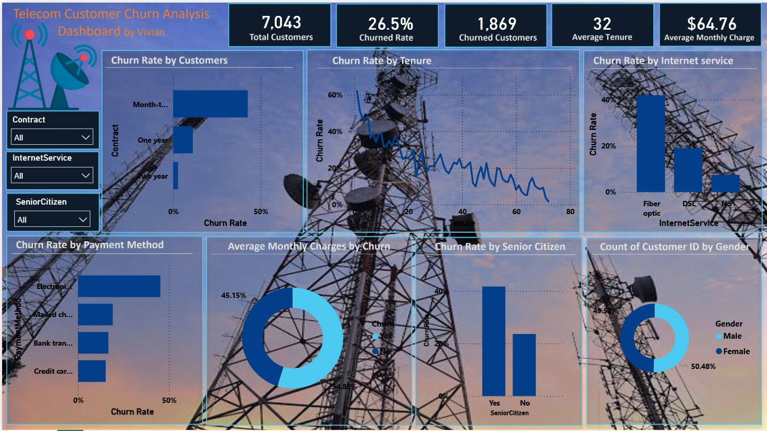
KEY VISUALIZATIONS
The Power BI Dashboard

Slide 5
MAJOR FINDINGS
What Drives Churn
Contract type is the #1 driver
Churn is front-loaded by tenure
Month-to-month customers churn at 40%+, vs ~10% for one-year and under 5% for two-year contracts.
New customers churn at 50-60% in their first months; the rate falls steadily as tenure grows.
Fiber optic customers churn most
Churned customers pay more
Fiber optic churns ~40%, far above DSL (~19%) and no-internet customers (~7%).
Churned customers average $74.44/month vs $61.27 for retained customers a $13 gap.
Senior citizens are higher risk
Electronic check payers churn most
Seniors churn at ~40%, roughly double the rate of non-senior customers (~20%).
Electronic check has the highest churn rate of all payment methods.

Slide 6
RECOMMENDATIONS
Where to Focus Retention Efforts
Incentivize longer contracts: offer discounts or perks for switching from month-to-month to annual plans.
Launch an early-tenure retention program: proactive onboarding and milestone offers in a customer's first 10 months.
Review fiber optic pricing and service quality to address its outsized churn rate.
Encourage automatic payment methods over electronic check through small incentives.
Create a senior citizen support track with simplified plans and dedicated service.

Slide 7
CONCLUSION
Churn Is Concentrated, Not Random
Churn at this company is driven by a small set of identifiable factors - flexible contracts, early tenure, fiber optic service, higher monthly charges, senior citizen status, and manual payment methods. Targeting retention efforts at these specific segments is far more cost-effective than broad, company-wide campaigns, and gives the business a clear, evidence-based path to reducing its 26.5% churn rate.

